Slide 1
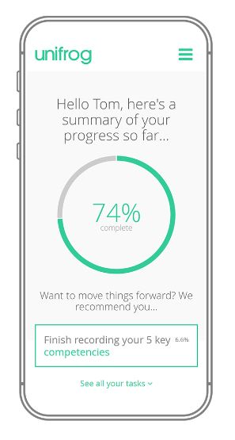


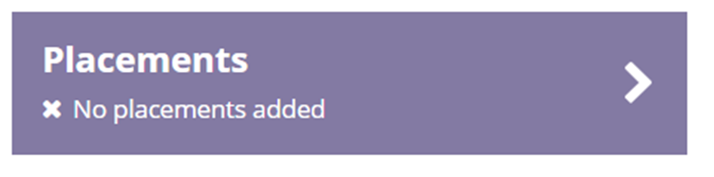
How to add your placement to unifrog:
Log into unifrog: Sign in at unifrog.org/sign-in
Sign in using your school email address. If you have forgotten your password, hit the link to reset.
Go to the Placements Tool (on the unifrog homepage)
Deadline to add placements:
Friday 30 January 2026
Step 2
When you are ready to add the placement, sign in to Unifrog, fill in the 'Student Initial Form' on the Placements Tool.
After that, the employer will receive an email from Unifrog inviting them to complete their part of the form.
Step 3
Once the employer has completed their section, the parent/carer will receive an email from Unifrog asking them to sign an agreement.
Step 4
Then your school coordinator (Miss Leigh) reviews all the information provided and gives consent for the placement to happen.
Step 1
Before adding a placement to the placements tool, the placement should first be agreed with the employer.
Double check that you’ve entered the employer’s email address correctly!
The placement can only go ahead once the school have given consent

Slide 2

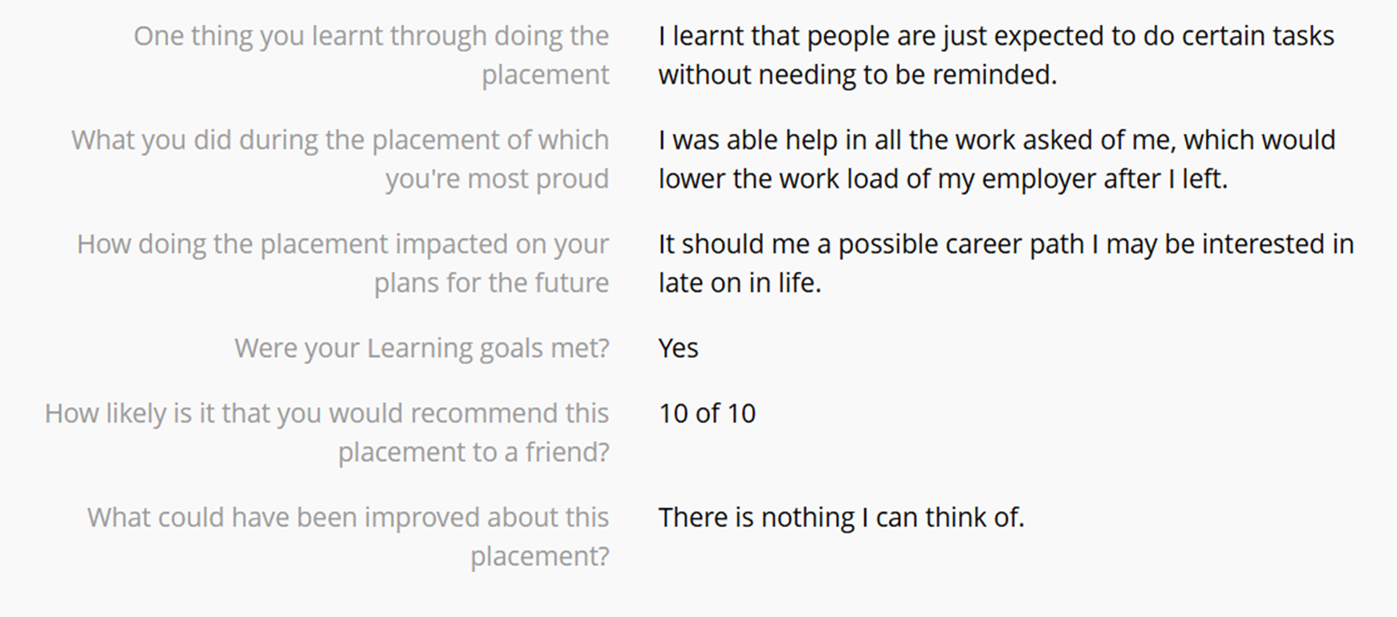
After the placement: Student Reflection

