Slide 1
Year 7 Parent Information Evening

Slide 2
Communication
If you have any concerns about your child, please do not hesitate to contact the Year 7 base ,where you will be able to speak to the Year 7 Leader -Mrs Jacobson or Deputy Year Leader- Mrs Coates.
Please copy in both members of staff for any email communication:
ajacobson@lordlawson.academy
kcoates@lordlawson.academy
My email is..........................................
Staff may not contact you during the school day, as they may be teaching but will try to contact you asap.
If there is an emergency please contact the main reception on :
0191 433 4026.
Notes:
2
Please inform parents if their call is urgent ring reception rather than sending an email ,as a member of staff may be teaching all day and may not pick this message up .

Slide 3
Attendance
We are working to improve attendance and punctuality throughout the academy . We hope to work closely with all parents and carers to ensure students meet our expectations. Student attendance should be 96% or above. All students are expected to be in the gates by 8.45am.
If your child is absent from school, please contact the Academy as early as possible on the day of absence.
Mrs Wallace and Mrs Ives both work in our Attendance office.
If you have any concerns regarding attendance, staff can be contacted at :
JWallace@lordlawson.academy
PIves@lordlawson.academy
Studentabsence@lordlawson.academy
Alternatively, please ring 0191 433 4026 and press 1 for the attendance team.
Throughout the year there will be several rewards offered to students who achieve excellent attendance; such as access to fun inflatables.
Notes:
3

Slide 4
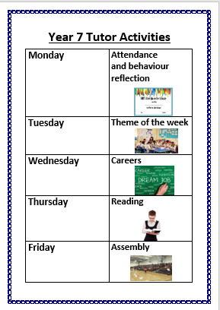
Tutor Activities
Monday – Attendance and behaviour reflection
Tuesday-Theme of the week -Personal Development
Wednesday –Careers
Thursday –Reading
Friday –Assembly

Slide 5
Year 7 Homework Schedule
Please see homework handout which shows days students will receive homework depending on the English class that they are in.
All the Year 7 classes are identified in the homework schedule after their assigned English class. The English class title can be found on the student's timetable. In addition to the timetabled homework, students will also receive reading homework each week.
Students, at times across the half term, will also receive homework from other subjects. Homework should take between 20-30 minutes per task, and we will always try to ensure that students have at least two nights to complete the work set.
Students can also attend the Library on a lunchtime and after school until 4pm.(They will need to purchase a pass from Miss Dixon in the Library for lunchtime access)
If students have any issues with homework ,please speak to the teacher initially and then the year base or tutor if you continue to have concerns.

Slide 6
Using Tutor Time to Support Reading
Tutors will choose an appropriate book to read with their class during tutor time.
Additional support for identified Year 7 Students
Paired reading Programme with Year 12 and 13
Reading Plus Programme
Small group Reading Programme
Lexia reading programme –for students who require further intensive intervention
This Photo by Unknown Author is licensed under CC BY-NC-ND

Slide 7
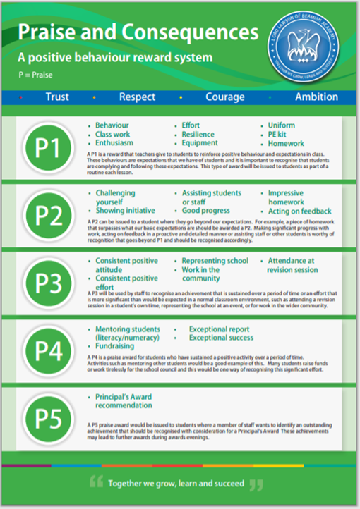
Class Charts
Praise
Nothing makes teachers happier than being able to praise students when they have done something positive.
When we issue P points, we are saying that you are doing exactly what we want.
If parents have the Class Charts app then they will also be able to see the positives that have been added.
Each half term we will be celebrating the successes of students and rewards will be given .
Notes:
Please stress rewards

Slide 8
High levels of positive behaviour are very important for all students to be able to reach their potential in class
The consequence system is there to support students to make the right choices – choices that we think are the best way of behaving and helping to resolve an issue
School sanctions are based mainly on detentions
These detentions are set at the convenience of your teacher. This may be a breaktime, lunchtime or after school.
Notes:
Tutor please explain each stage C2 -15 min detention ,C3 -30 min detention (Move to friendly neighbour) c4 –Learning Support Room

Slide 9
School Lunches
For those students who receive free school meals, the money paid by the authority does not show on the students' cash loading machines in the Academy. However, the dining hall are aware of all pupils who are entitled to a FSM and monies show on the central system. Free school meals entitlement must be used every day, as monies do not roll over to the next day.
Please note students who gain FSM ,if they buy a sausage sandwich for example at breaktime ,they will not have enough money for a school dinner at lunch . Please advise your child to wait until lunchtime.
For students paying for their meals, money will be taken from their account as it’s used. Use of the parent pay system is the easiest way to provide money.
If your child either forgets their dinner money or does not have enough money on their account ,they will be provided with a basic meal However, students are expected to pay for this meal the next day.

Slide 10
Equipment and Labelling Personal belongings
All students are expected to have the basic equipment for school(pen, pencil, ruler, rubber) carried in a bag.
Could parent/carers please name your child’s personal belongings and clothing, so items can be returned to the correct owner if misplaced.
If your child loses their tie, these can be purchased from the main reception at a cost of £6.00.
Jewellery should not be worn in the Academy and it will be confiscated immediately by staff if seen.
Many thanks for your support with uniform .

Slide 11
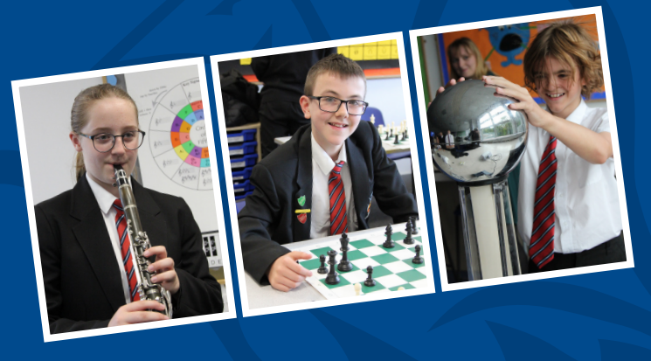
Extra – Curricular Activities
Students can share an interest with new friends and develop their self- confidence and self- esteem. All students will be notified by tutors of the various clubs taking place in the Academy.
They are an important part of school life and are recognised by staff through the reward system.
Achievements of our students are celebrated in Year based Celebration Assemblies and during our reward evenings held in July
Please take an extra –curricular booklet this evening .

Slide 12
Pantomime
We are all looking forward to the Pantomime on the14th December .
Oh yes we are!
If you have still not replied –Friday 20th October 2023 is the very last date for any reply slips.
There is financial support for this event. If you are requiring this please do not hesitate to contact Mrs Jacobson/Mrs Coates, so we can involve as many Year 7 students as possible before the deadline date .No child should miss this event for financial reasons.

Slide 13
Thankyou for listening
Any Questions?
Notes:
13

