Slide 1
Year 7
Meet the tutor evening

Slide 2
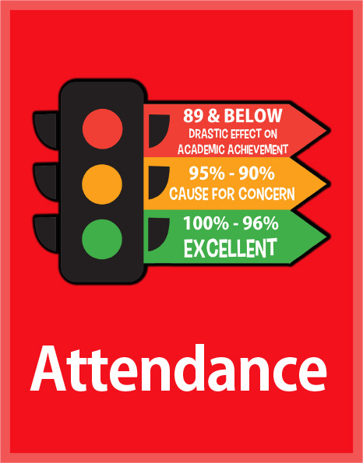
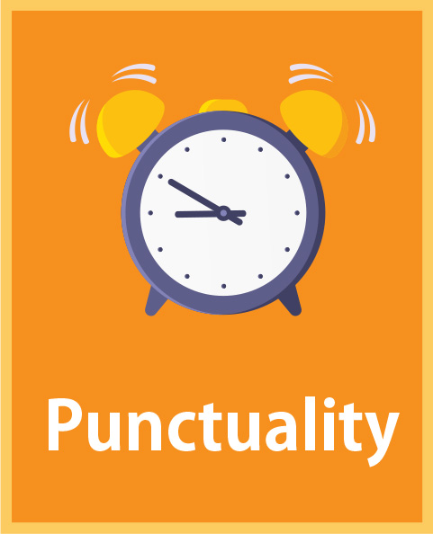

Slide 3
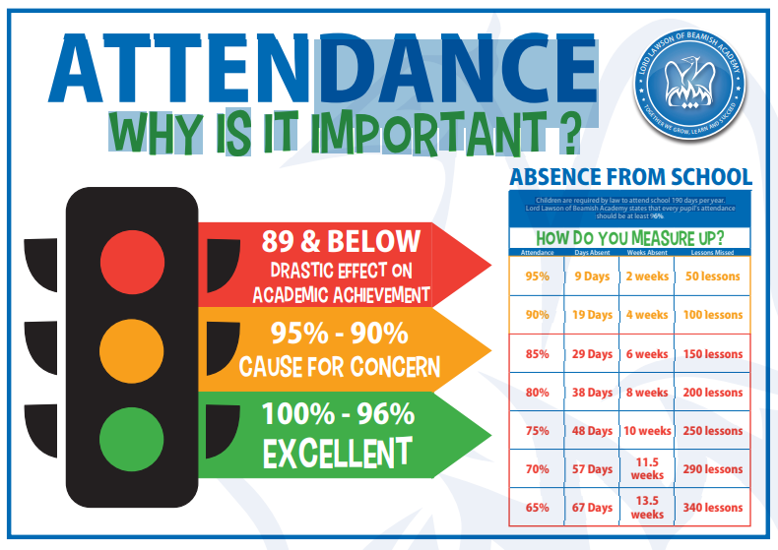

Slide 4
Preparing for success
Punctuality to lessons – getting to lessons faster will make it easier for students to learning
Habits of attention – what students pay attention to is ultimately what they will learn. We are using STAR to support students in lessons
Silence is golden – silence allows students to focus independently on applying the thing they have just learnt
Notes:
he action of paying close attention to something.

Slide 5
Platform | Features
Class Charts | Announcements Behaviour (praise, consequences, and detentions) Homework Timetables
My Child at School (MCAS) | Attendance Academic progress reports

Slide 6
Key dates
2 March 2024 – Academic data reports available
2 May 2024 – Parents evening (online)
12 July2024 – Academic data reports available

